Slide 1

IFFAT ZABIN
Dept. of Electrical & Computer Engineering
Roll No: 1510004
Course Title: Software Development Project – I
Course No: ECE - 2100
Supervised By-
TASNIM BINTE SHAWKAT
Lecturer, Dept. of ECE

Slide 3
Index

Slide 4
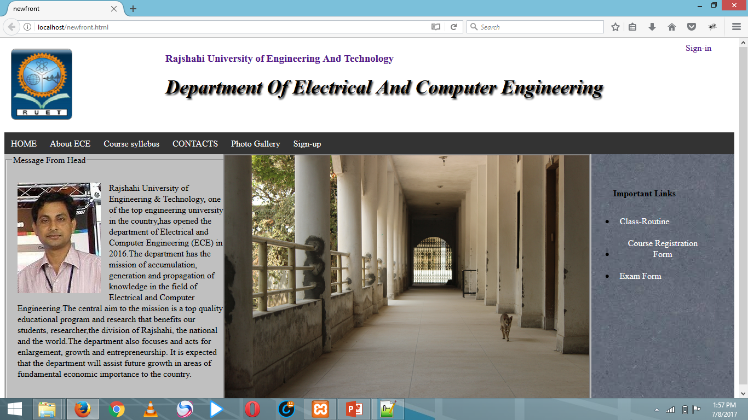

Slide 5
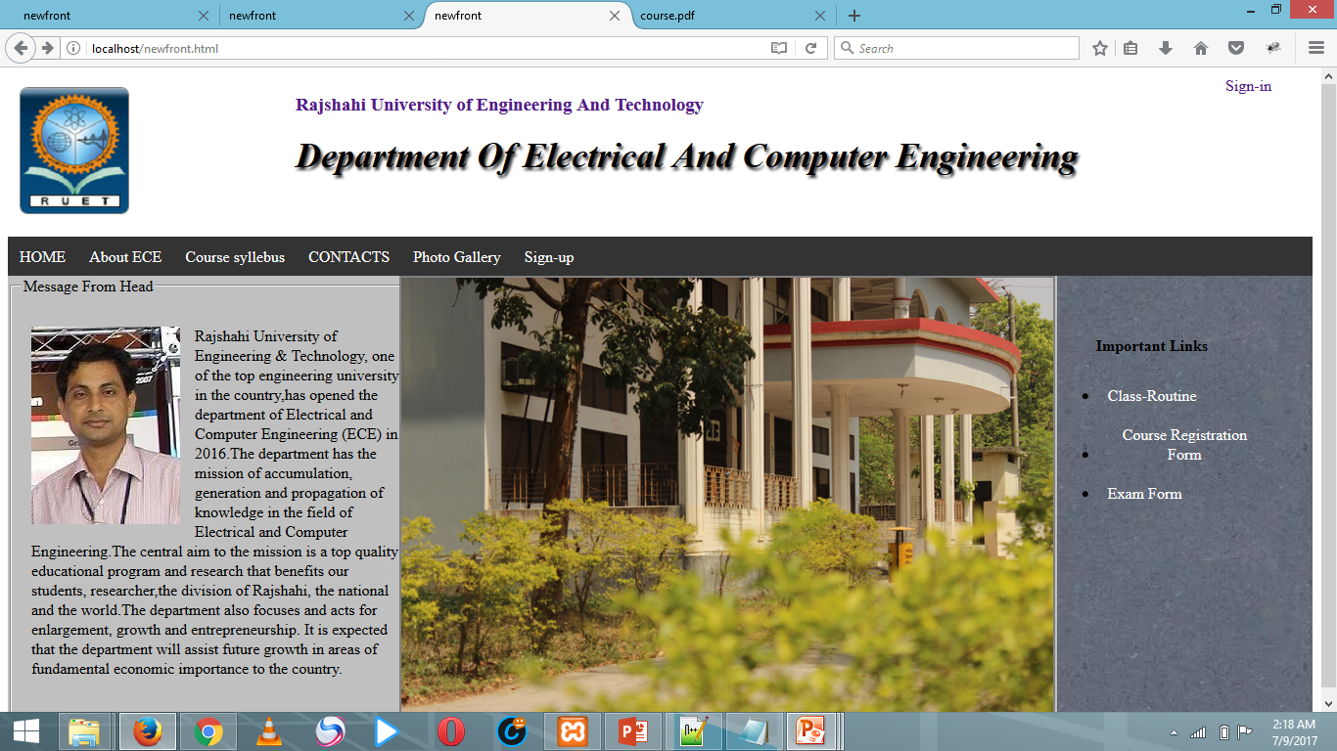
HOME PAGE

